Slide 1
Online Examination System

Slide 2
Important Pages
StudentRegistrationServlet : where the student can register and details get stored into the database.
TeacherRegistrationServlet : where the teacher can register and details get stored into the database.
StudentLoginServlet : Student can login if student has already registered.
TeacherLoginServlet : Teacher can login if teacher has already registered.
ValidationFilter : It is used for above files.
WelcomeExam.jsp : where the student can appear for the test.
ExamServlet : is used for calculating score.
CreateQuesServlet : Teacher can create questions
WelcomeData.jsp : where teacher can see student name and marks.
SelectQuestions.jsp : where teacher can see all the questions and answers.

Slide 3
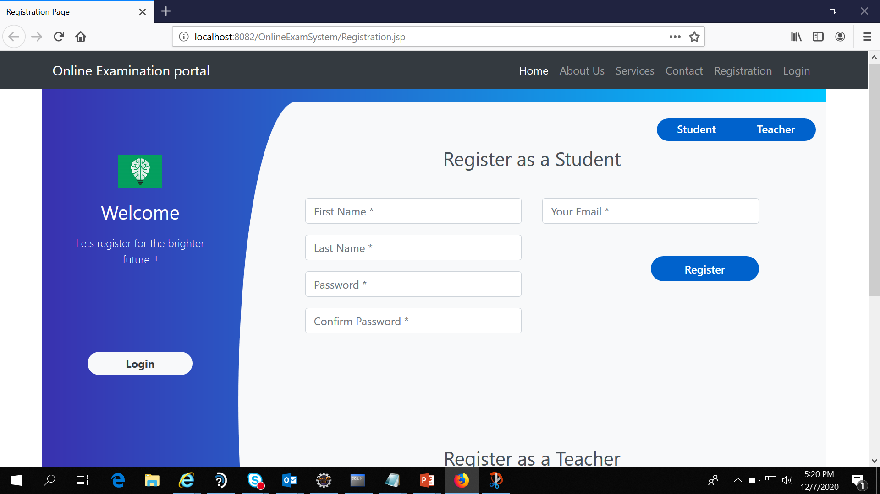
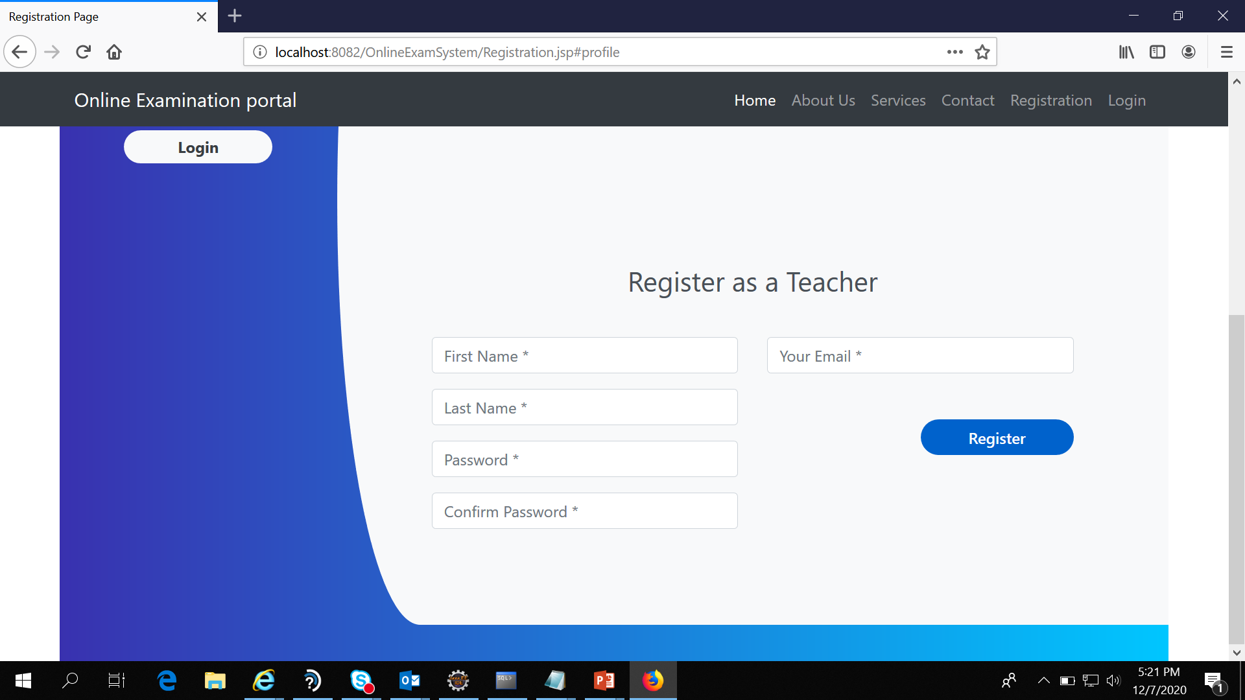
Registration Page

Slide 4
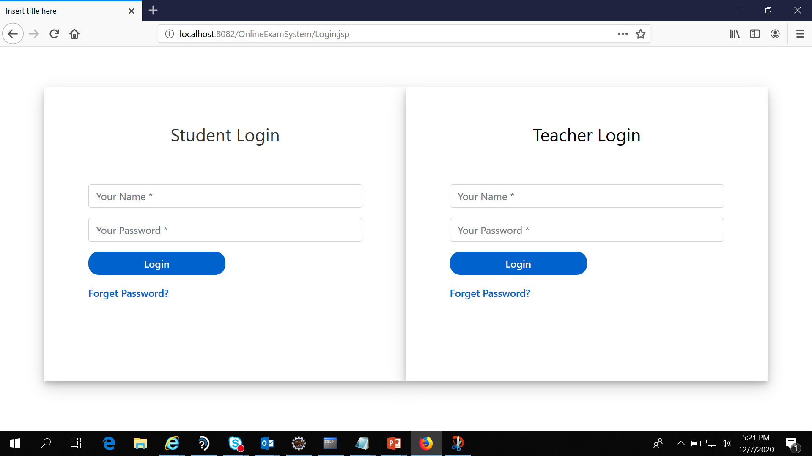
Login Page

Slide 5
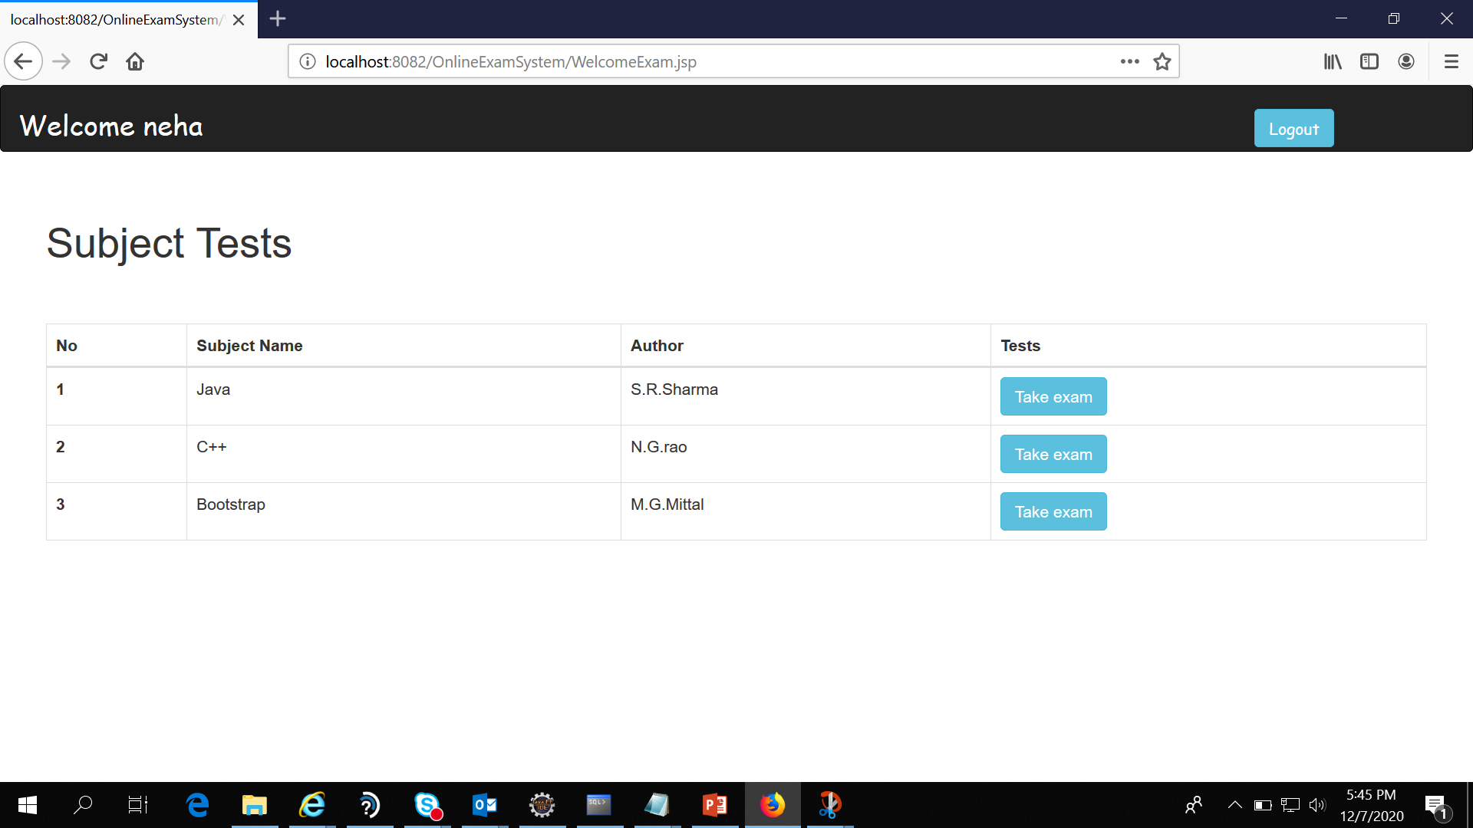
Student can give exam

Slide 6
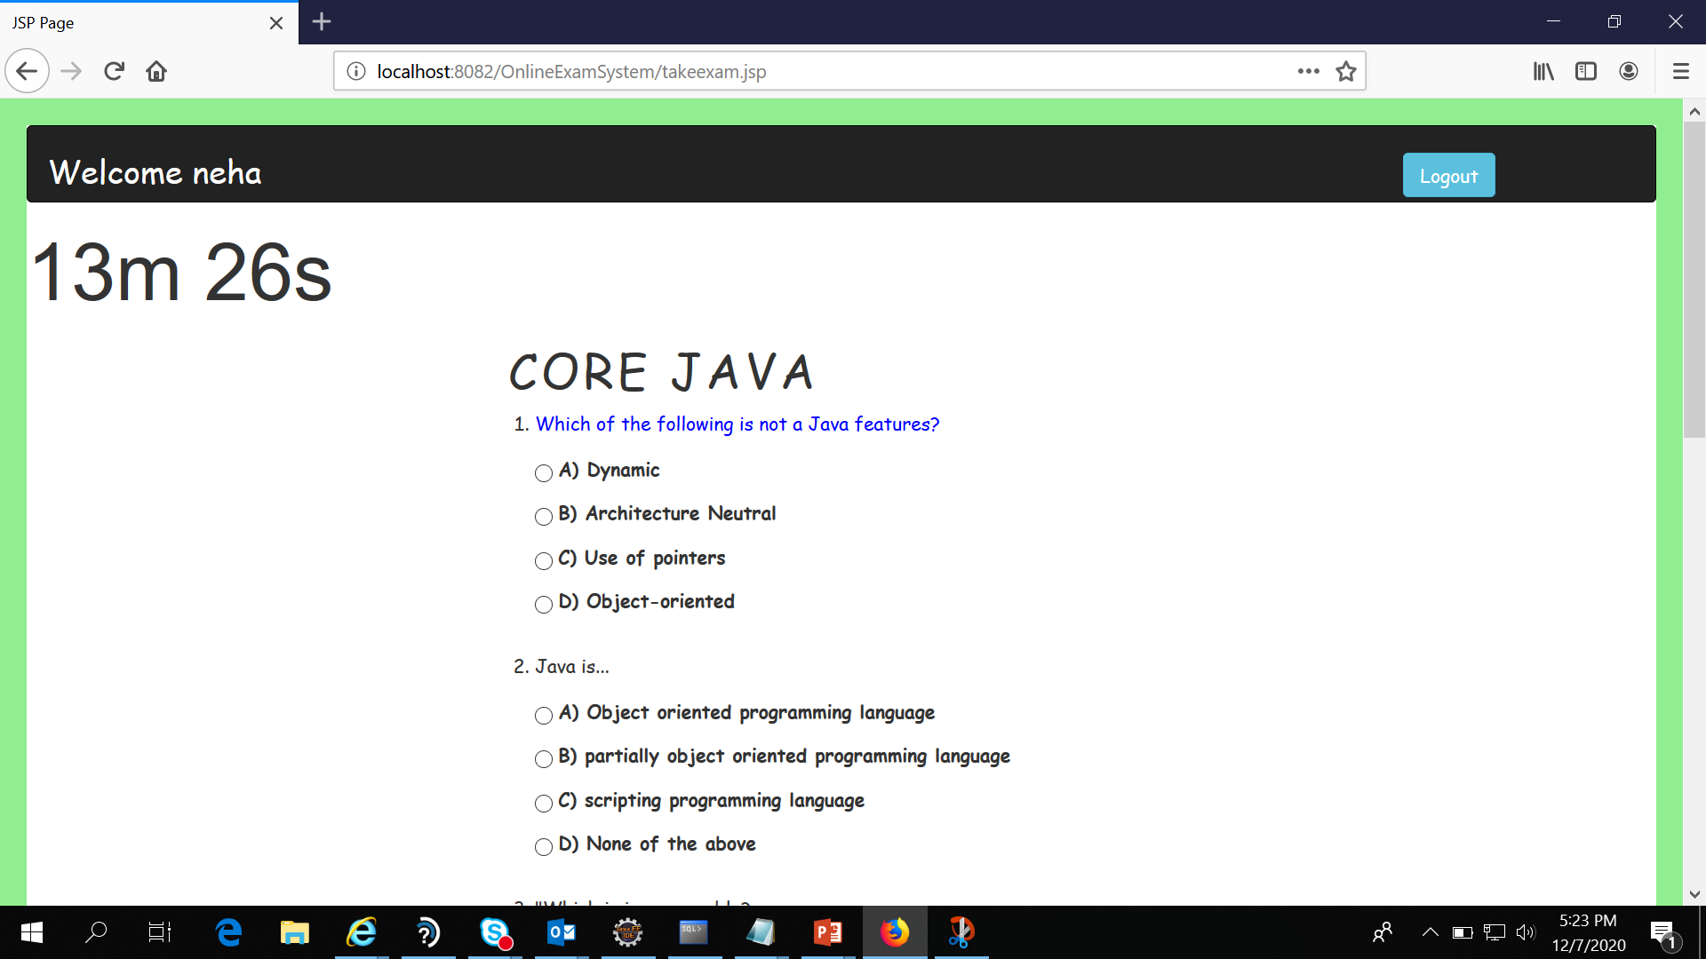

Slide 7
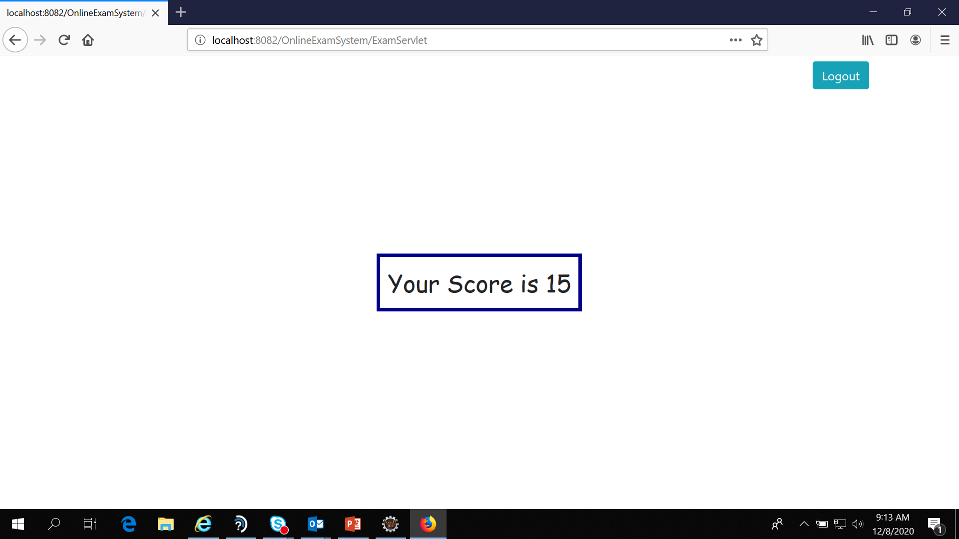

Slide 8
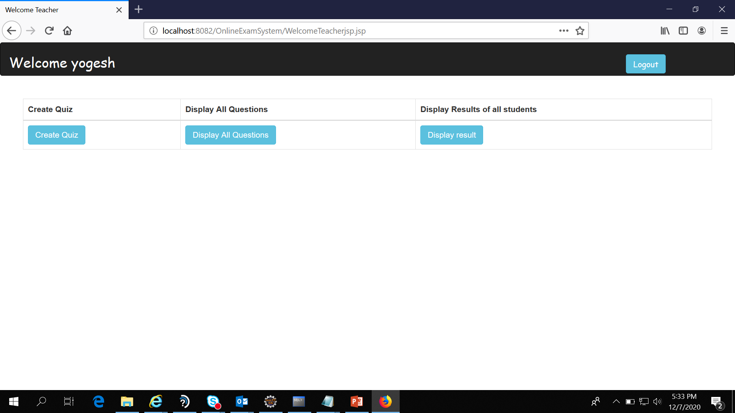

Slide 9
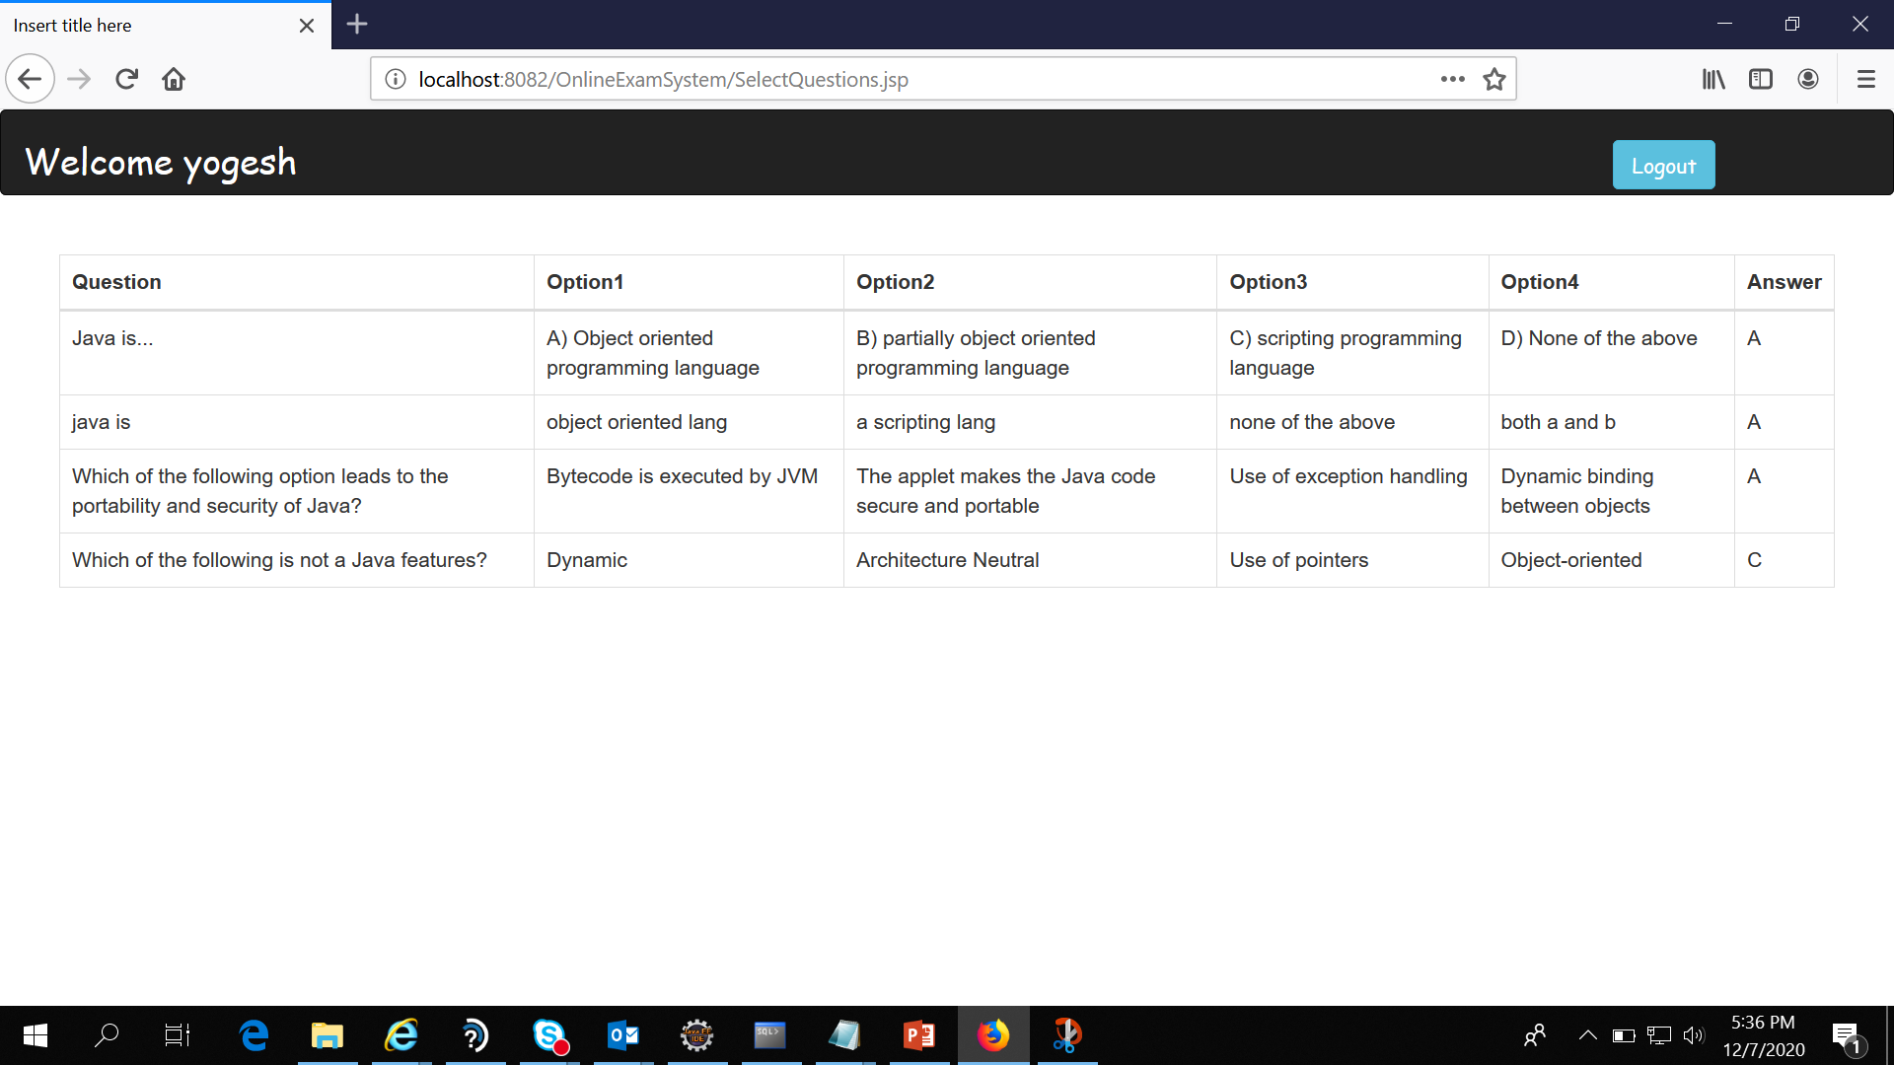
Teacher can see questions and answers

Slide 10
Thank you

